Slide 1
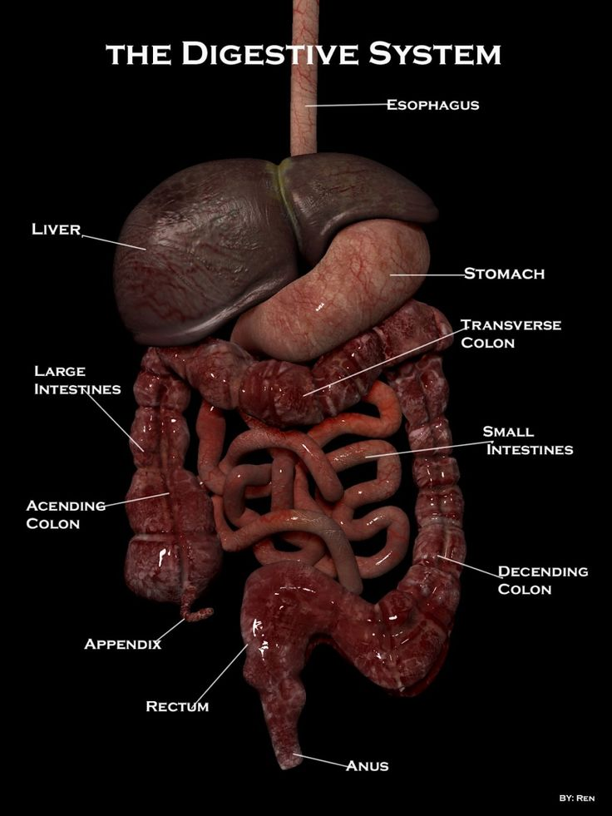
The Digestive System

Slide 2
Homework
Complete Cornell notes on the digestive system slides. Use them to complete your system function worksheet.

Slide 3
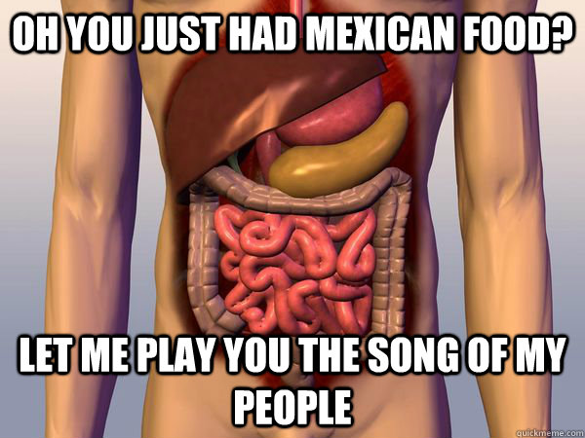
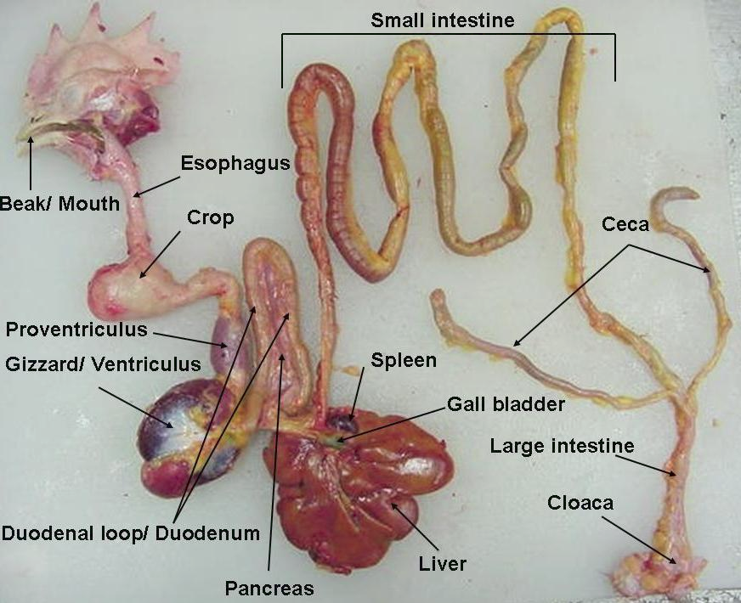
Major Functions
Ingestion
Propulsion
Food breakdown: mechanical digestion
Food breakdown: chemical digestion
Absorption
Defecation

Slide 4
Food Ingestion and Breakdown
Food must be placed into the mouth before it can be acted on. This is an active, voluntary process called ingestion.
Food is placed in the mouth, both mechanical and chemical digestion begin at this point
The food is physically broken down into smaller particles by chewing. Saliva then begins the chemical proses.
Saliva is normally secreted continuously to keep the mouth moist; but, when food enters the mouth, much larger amounts of saliva pour out.
No food absorption happens in the mouth.
The pharynx and esophagus have no digestive function; they simply provide passageways to carry food to the stomach.

Slide 5
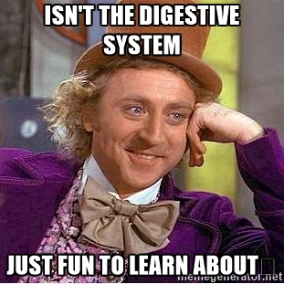
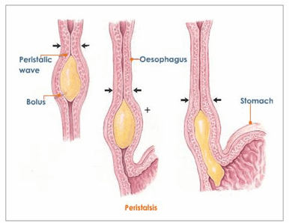
Food Propulsion
Food must first be swallowed. Swallowing is a complicated process that involves the coordinated activity of several structures (tongue, soft palate, pharynx, and esophagus).
It has two major phases:
1. The voluntary buccal phase, occurs in the mouth. Once the food has been chewed and well mixed with saliva, the bolus is forced into the pharynx by the tongue.
2. The involuntary pharyngeal-esophageal phase, transports food through the pharynx and esophagus.
The parasympathetic division of the autonomic nervous system controls this phase.
Food is moved through the pharynx and then into the esophagus below by wavelike peristaltic contractions of their muscular walls—first the longitudinal muscles contract, and then the circular muscles contract.

Slide 6
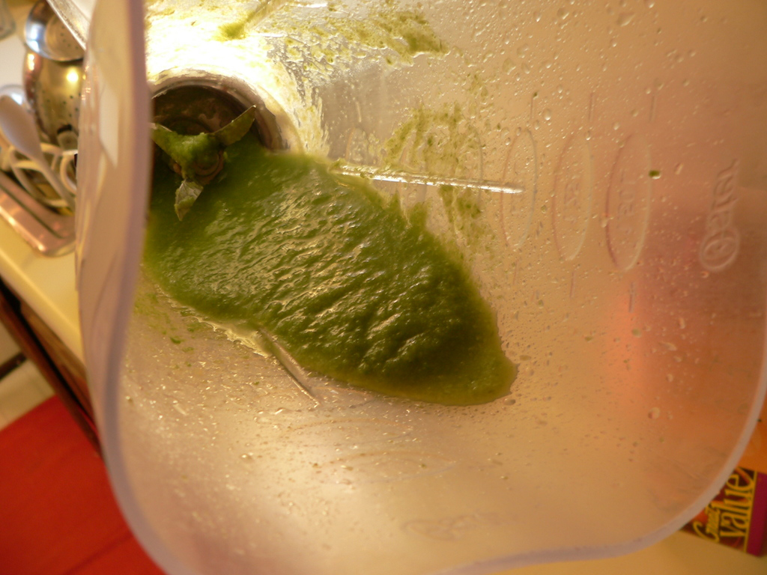
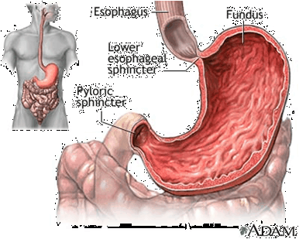
Contributions of the Stomach Food Breakdown ( Read the paragraph and break it down into useful notes.)
Secretion of gastric juice is regulated by both neural and hormonal factors. The sight, smell, and taste of food stimulate parasympathetic nervous system reflexes, which increase the secretion of gastric juice by the stomach glands. In addition, the presence of food and a falling pH in the stomach stimulate the stomach cells to release the hormone gastrin. Gastrin prods the stomach glands to produce still more of the protein-digesting enzymes (pepsinogens), mucus, and hydrochloric acid. Under normal conditions, 2 to 3 liters of gastric juice are produced every day. The extremely acidic environment is necessary, to activate pepsinogen to pepsin, the active protein digesting enzyme. Rennin, the second protein-digesting enzyme produced by the stomach, works primarily on milk protein and converts it to a substance that looks like sour milk. As food enters and fills the stomach, its wall begins to stretch (at the same time the gastric juices are being secreted). Then the three muscle layers of the stomach wall become active. They compress and pummel the food so that the semi-fluid chyme is formed.

Slide 7
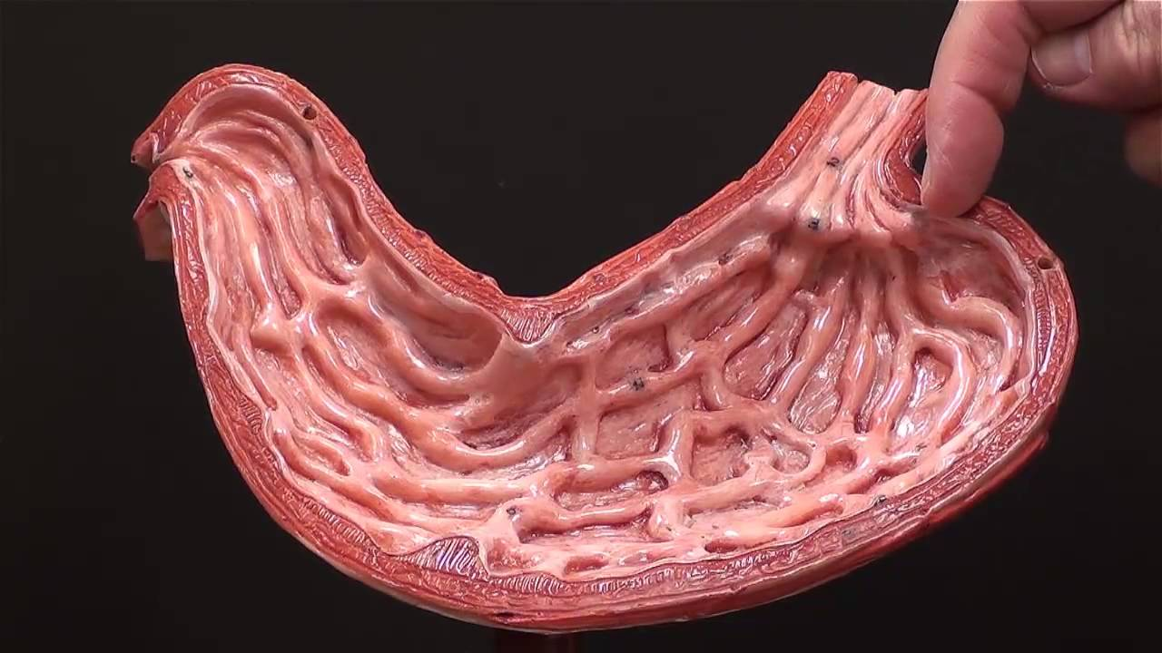
Food Propulsion (Stomach)
Once the food has been well mixed, a rippling peristalsis begins in the lower half of the stomach. The pylorus of the stomach, which holds about 30 ml of chyme, acts like a meter that allows only liquids and very small particles to pass through the pyloric sphincter. When the duodenum is filled with chyme and its wall is stretched, a nervous reflex, the enterogastric reflex, occurs. This reflex slows the emptying of the stomach. Generally, it takes about 4 hours for the stomach to empty completely after eating a well-balanced meal and 6 hours or more if the meal has a high fat content.

Slide 8
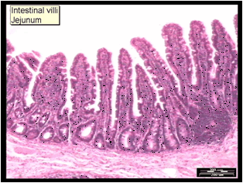
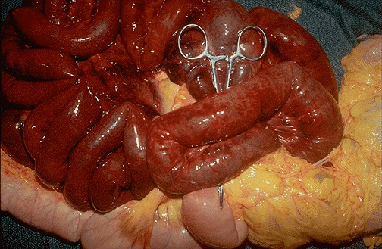
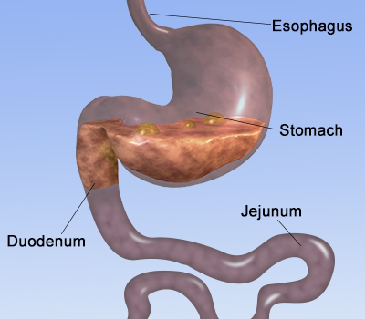
Small Intestines ( Food breakdown and absorption)
Food reaching the small intestine is only partially digested. Carbohydrate and protein digestion have been started, but virtually no fats have been digested up to this point. Here the 5 process of chemical food digestion is accelerated as the food takes about 3-6 hour journey through the small intestine. By the time the food reaches the end of the small intestine, digestion is complete and nearly all food absorption has occurred. The microvilli of small intestine cells bear a few important enzymes, the so-called brush border enzymes that break down double sugars into simple sugars and complete protein digestion. Intestinal juice itself is relatively enzyme-poor, and protective mucus. However, foods entering the small intestine are literally deluged with enzyme-rich pancreatic juice.

Slide 9
Small Intestines ( Food breakdown and absorption continued)
Pancreatic juice contains enzymes that (1) along with brush border enzymes, complete the digestion of starch (pancreatic amylase): (2) carry out about half of protein digestion (via the action of trypsin, chymotrypsin. carboxypeptidase, and others); (3) are totally responsible for fat digestion since the pancreas is essentially the only source of lipases; and (4) digest nucleic acids (nucleuses). In addition to enzymes, pancreatic juice contains a rich supply of bicarbonate, which makes it very basic (about pH 8). When pancreatic juice reaches the small intestine, it neutralizes the acidic chyme coming in from the stomach and provides the proper environment for intestinal activity and pancreatic digestive enzymes. The release of pancreatic juice into the duodenum is stimulated by both nerves and local hormones. Bile is not an enzyme, acts like a detergent to emulsify, or mechanically break down, large fat globules into thousands of tiny ones, providing a much greater surface area for the pancreatic lipases to work on. Bile is also necessary for absorption of fats and other fat-soluble vitamins [K. D, and A] that are absorbed along with them

Slide 10
Small Intestines ( Food breakdown and absorption continued)
Absorption of water and of the end products of digestion occurs all along the length of the small intestine. Most substances are absorbed through the intestinal cell plasma membranes by the process of active transport. Then they enter the capillary beds in the villi to be transported in the blood to the liver via the hepatic portal vein. The exception seems to be lipids, or fats, which are absorbed passively by the process of diffusion. Lipid breakdown products enter the capillary beds in the villi and are carried to the liver by both blood and lymphatic fluids. At the end of the ileum, all that remains is some water, indigestible food materials (plant fibers such as cellulose), and large amounts of bacteria. This debris enters the large intestine through the ileocecal valve

Slide 11
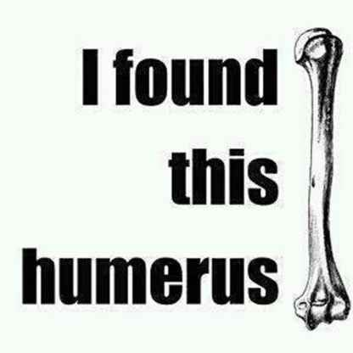
Food Propulsion
Food Propulsion As mentioned previously, peristalsis is the major means of propelling food through the digestive tract. It involves waves of contraction that move along the length of the intestine, followed by waves of relaxation

Slide 12
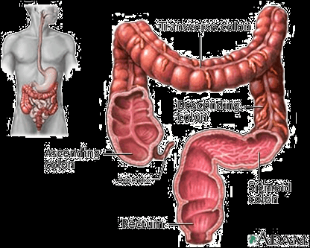
The Large Intestine ( Breakdown)
What is finally delivered to the large intestine contains few nutrients, but that residue still has 12 to 24 hours more to spend there. The colon itself produces no digestive enzymes. However, the bacteria that live within its lumen metabolize some of the remaining nutrients, releasing gases (methane and hydrogen sulfide) that contribute to the odor of feces. About 500 ml of gas (flatus) is produced each day. Bacteria residing in the large intestine also make some vitamins (vitamin K and some B vitamins). Absorption by the large intestine is limited to the absorption of these vitamins, some ions, and most of the
remaining water. Feces, the more or less solid product delivered to the rectum, contain undigested food residues, mucus, millions of bacteria, and just enough water to allow their smooth passage.

Slide 13
Propulsion of the Residue and Defecation (Pooping)
Peristalsis and mass movements are the two major types of propulsive movements occurring in the large intestine. Colon peristalsis is sluggish and, compared to the mass movements, probably contributes very little to propulsion. Mass movements are long, slow-moving but powerful contractile waves that move over large areas of the colon three or four times daily and force the contents toward the rectum. Typically, they occur during or just after eating, when food begins to fill the stomach and small intestine. The rectum is generally empty, but when feces are forced into it by mass movements and its wall is stretched, the defecation reflex is initiated and the feces are forced through the anal canal, anus to the outside.

Slide 14
Three parts of the digestive system that do not touch the food.
1. Liver
2. Gall Bladder
3. Pancreas

Slide 15
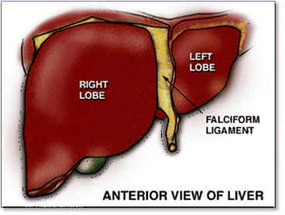
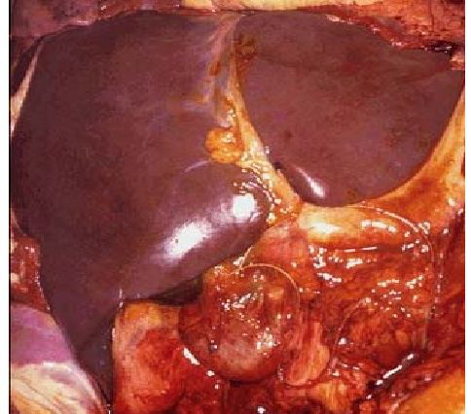
Liver
• Largest internal organ
• Produces a greenish liquid called bile that breaks down fat

Slide 16
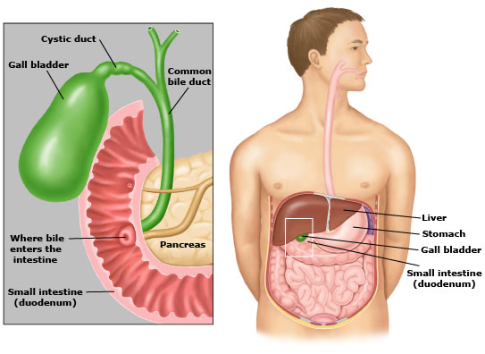
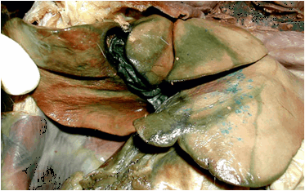
Gall Bladder
• Stores bile from the liver. Secretes it into the duodenum when needed

Slide 17
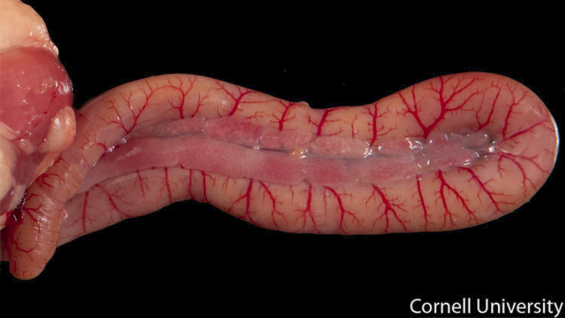
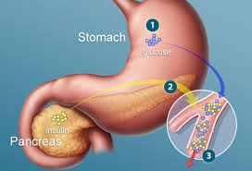
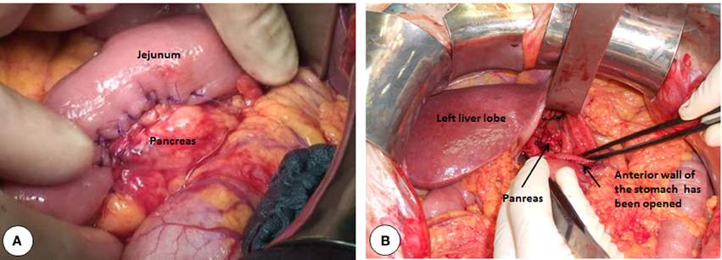
Pancreas
Produces chemicals to break down protein and carbohydrates
Chemicals are secreted into the duodenum

