Slide 1
Surprise Quiz!!!
You may use your notes (in your notebook only)
1. Name three different joints, and give an example of where each is located.
2. What are three of the five main functions of the skeletal system?
3. What are immovable joints, and where can you find 2 of them?

Slide 2
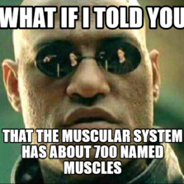
The Muscular System

Slide 3
Muscle Facts
1. It takes 17 muscles to smile, and 43 to frown
2.The strongest muscle in your body is the tongue.
3.It takes 200 muscles in order for you to take 1 step.
4.muscles make about 40% of your body weight.
5. There are about 650 muscles in your body.
6. The muscles that control your eyes, move over 100,000 times per day.
7.There are over 30 muscles in the human hand.
8.Your lips are red because the skin is so thin that you can see the muscles below it.
9. You get goosebumps when you're cold because tiny muscles beneath the skin contract to close the pores on the skin and prevent some body heat from escaping. This causes the hair on your skin to stand up

Slide 4
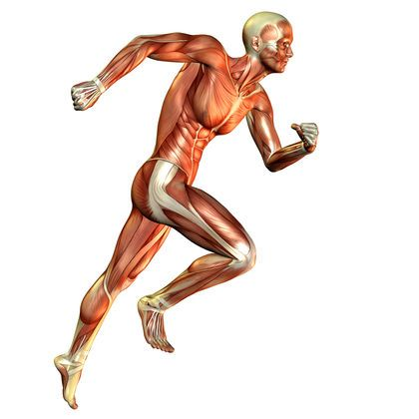
Major Functions
1. Movement:
- Muscles contract and relax to allow movement.
2. Maintaining Body Temperature. (Homeostasis)
- When muscles contract they create heat.
* When does your body do this?
3. Maintains Posture:
- Muscles help you stand and sit in the upright position.
4. Protection: (Abs of steel):
-Your muscles form a protective layer around vital organs.
5. Necessary bodily functions:
- Muscles pump blood, help you breathe and digest food.

Slide 5
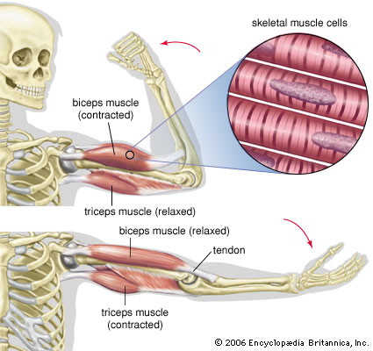
Types of Muscle movement
1. Voluntary Movement:
- Muscle whose action is normally controlled by an individual's will; mainly skeletal muscle, composed of parallel bundles of striated, multinucleate fibers.
- Example: Arms and Legs.
2. Involuntary Muscles:
Any of the smooth muscles, plus the cardiac muscle, not under control of the person will.
Cardiac muscles are striated.
-Examples: Heart and Stomach
http://www.dictionary.com/browse/voluntary-muscle

Slide 6
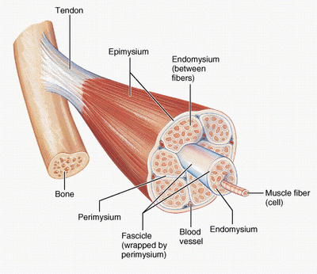
Anatomy of a muscle
Fascicle: Bundle of Muscle fibers.
Muscle Fiber: Muscle Cell
Perimysium: Connective tissue that groups
muscle fibers together.
Epimysium: Connective tissue encloses entire muscle.
Tendon: a flexible but inelastic cord of strong fibrous collagen tissue attaching a muscle to a bone.
Endomysium: Layer the encloses individual muscle fibers.

Slide 7
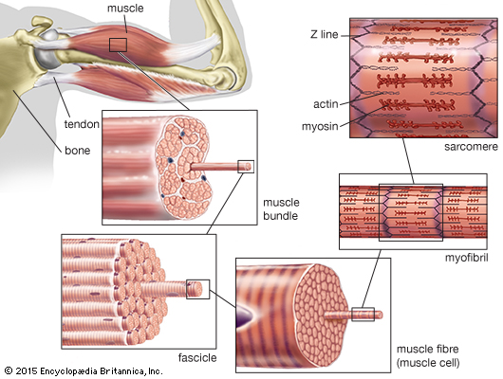
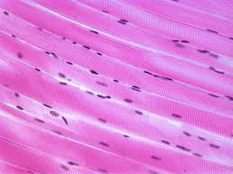
Types of Muscle tissue
1. Skeletal Muscle:
- Voluntary muscles that are attached to the skeleton.
Form part of the mechanical system that moves limbs
and other parts of the body.
Stimulated by a nerve the muscle contracts causing
movement.
-Example: Arms, legs, neck, back

Slide 8
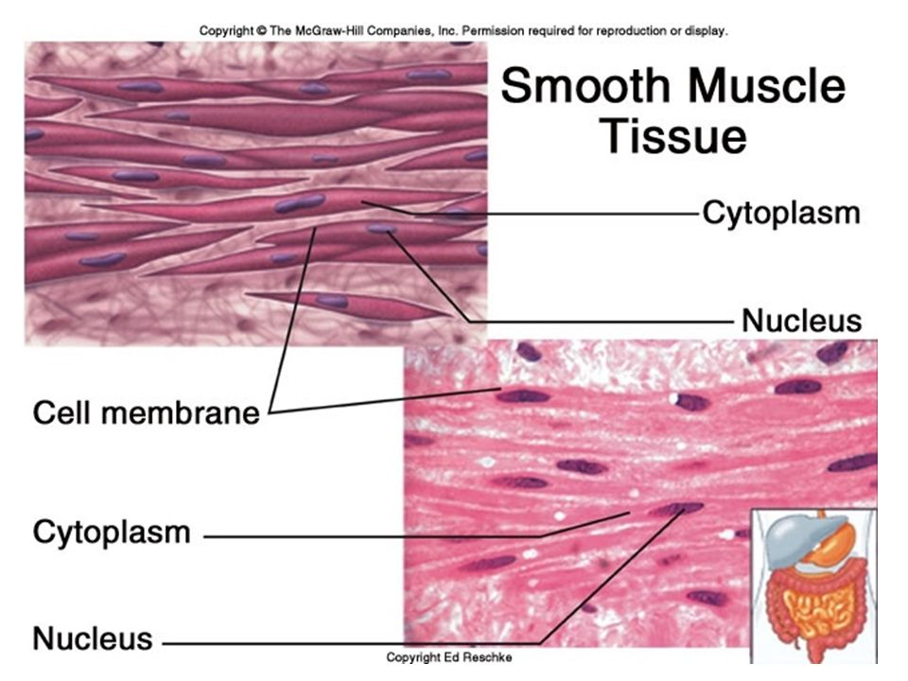
Types of muscle tissue
2. Smooth Muscle:
Smooth muscle generally forms the supporting tissue of blood vessels and hollow internal organs, such as the stomach, intestine, and bladder. It is considered smooth because it does not have the microscopic lines (the striations) seen in the other two types of muscle.
- Responsible for function of hollow organs.
- Part of the involuntary muscle system.
- Some places you can find smooth muscles:
1. Blood vessels
2. Stomach
3. Intestines
4. Bladder
5. Respitory Tract
http://www.medicinenet.com/script/main/art.asp?articlekey=5514

Slide 9
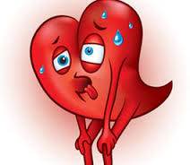
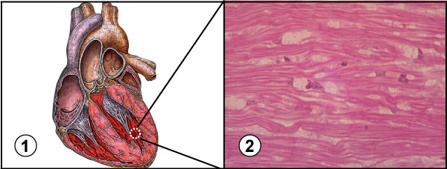
Types of muscles
3. Cardiac Muscles:
- a specialized form of striated muscle occurring in the hearts of vertebrates.
- Involuntary muscle in charge of the everyday operation of your heart.
- Contracts to pump blood in and out of the heart to the rest of you body.
-Works 24 hours a day 7 days a week for your entire life.
-Heart beats about 100,000 times per day.

Slide 10
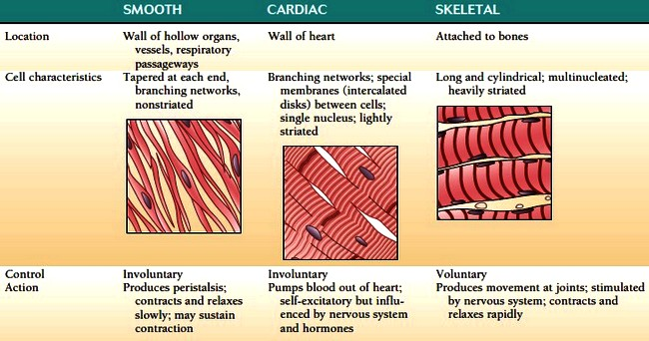

Slide 11
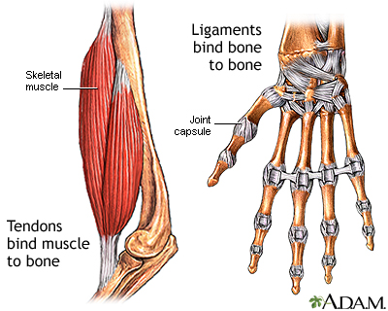
tendons
Flexible but inelastic cord of strong fibrous collagen tissue attaching a muscle to a bone.
A tendon is a fibrous connective tissue which attaches muscle to bone.
Tendons may also attach muscles to structures such as the eyeball. A tendon serves to move the bone or structure.
A ligament is a fibrous connective tissue which attaches bone to bone, and usually serves to hold structures together and keep them stable.

Slide 12
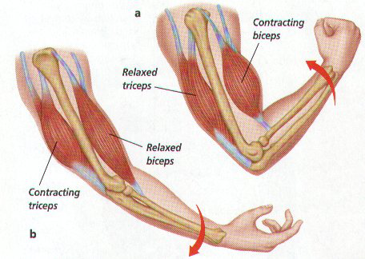
Muscle pairs
1. All skeletal muscles work in pairs.
2. Antagonistic pairs of muscles create movement when one (the prime mover) contracts and the other (the antagonist) relaxes.
Examples of antagonistic pairs working are: the quadriceps and hamstrings in the leg. the biceps and triceps in the arm.

Slide 13
Muscle system assignments
1. Human body poster.
2. find a muscle that represents each of the five functions of the muscular system.
Name of muscle
Location
Function (detailed description)

